Slide 1
IOT-BASED SMART IRRIGATION AND PLANT DISEASE DETECTION FOR SUSTAINABLE FARMING

Slide 2
ABSTRACT
Real-time monitoring of soil moisture, water level, and temperature.
Automated irrigation and fertilizer control for optimal crop growth.
Machine learning model to detect diseases in rice leaves.
Fertilizer recommendations based on identified diseases.
Supports sustainable agriculture by reducing resource wastage and human effort.

Slide 3
INTRODUCTION
Addresses modern agricultural challenges such as population growth, climate change, and resource scarcity.
Replaces traditional farming methods with automated, tech-driven precision farming techniques.
Automates irrigation and fertilization based on real-time soil and environmental data.
Incorporates machine learning to detect diseases in rice leaves at an early stage.
Provides disease-specific fertilizer recommendations to improve treatment and crop yield.
Enhances efficiency and sustainability by minimizing manual labor and optimizing resource usage.

Slide 4
OBJECTIVE
IoT-based automated irrigation using real-time soil and water level data.
Enables precision fertilizer application through IoT-enabled environmental monitoring.
IoT and machine learning for early crop disease detection and smart recommendations.
Enhances resource efficiency by minimizing water and fertilizer waste via IoT sensors.

Slide 5
LITERATURE SURVEY
S.NO | TITLE | AUTHORS | JOURNALS WITH YEAR | DESCRIPTION | DRAWBACKS
1 | Precision Agriculture Robot for Seeding Function and Leaf Detection | Lokanandam J K S Sai Ganesh, Mohit N Raate, Nithin T N, Pavan G, and Prof. Nithya Shree | International Journal of Engineering Research & Technology (IJERT), Vol. 9, No. 08, August 2020 | This study presents a precision agriculture robot designed to automate seeding and leaf detection. The robot integrates sensors and machine learning techniques to identify plant health and seed placement with precision, reducing labor costs and improving crop yields. | The system is focused mainly on specific tasks like seeding and leaf detection, and its scalability and adaptability to different crop types are not thoroughly addressed.
2 | Design and Comparative Analysis of On-Chip Sigma Delta ADC for Signal Processing Applications | P.A.H. Vardhini, M.L. Makkena | International Journal of Speech Technology, Vol. 24, 2021 | Focuses on signal processing using Sigma Delta ADC in IoT systems, with potential agricultural applications in sensor data acquisition and processing. | The work is more hardware-centric and does not address complete smart farming architecture.

Slide 6
LITERATURE SURVEY
S.NO | TITLE | AUTHORS | JOURNALS WITH YEAR | DESCRIPTION | DRAWBACKS
3 | IoT-Enabled Smart Irrigation System Using Soil Moisture and Weather Prediction for Sustainable Agriculture | T. Ramesh, A. Verma, P. Srinivasan | International Journal of Electrical and Computer Engineering (IJECE), Vol. 12, No. 4, August 2022 | This study introduces an IoT-enabled smart irrigation system that combines soil moisture sensor data with real-time weathjer forecasting APIs to optimize irrigation cycles. It also allows remote monitoring via a mobile app interface. | Does not include plant disease detection or image analysis capabilities; focuses only on irrigation efficiency.
4 | IoT-Based Smart Farming System for Disease Detection and Automatic Irrigation | R. Meenakshi, V. Rajendran | International Journal of Advanced Computer Science and Applications (IJACSA), Vol. 14, No. 6, 2023 | Implements IoT sensors to monitor soil and environment conditions, paired with a camera module for plant disease detection using machine learning algorithms. | Limited scalability for large farms, and model accuracy depends heavily on image quality.

Slide 7
LITERATURE SURVEY
S.NO | TITLE | AUTHORS | JOURNALS WITH YEAR | DESCRIPTION | DRAWBACKS
5 | Deep Learning-Driven IoT Framework for Early Detection of Plant Diseases in Rice Farming | N. Sharma, K. Anand, M. Thomas | Computers and Electronics in Agriculture, April 2024 | Uses CNN models on image data collected via IoT cameras for detecting rice diseases like blast and blight. The system is integrated with an automatic alert mechanism for farmers. | Requires a large training dataset and high computational power for real-time inference in remote areas.

Slide 8
PROBLEM STATEMENT
Precision Agriculture Robot for Seeding Function and Leaf Detection[1]
  The system is task-specific, lacking scalability and adaptability across diverse crop types
IoT-Enabled Smart Irrigation System Using Soil Moisture and Weather Prediction for Sustainable Agriculture[2]
  Does not include plant disease detection or image analysis capabilities; focuses only on irrigation efficiency.
Deep Learning-Driven IoT Framework for Early Detection of Plant Diseases in Rice Farming[3]
  Requires a large training dataset and high computational power for real-time inference in remote areas.

Slide 9
PROPOSED SYSTEM
YOLO (You Only Look Once) is used for real-time image analysis to detect rice leaf diseases.
It processes the entire image in one pass, enabling fast and accurate disease identification.
IoT sensors monitor field conditions and motor status, sending real-time updates to the farmer via a mobile app.
The system reduces manual effort by automating key farming operations.
It minimizes resource wastage through data-driven irrigation and fertilization.
Overall, it improves crop health and increases agricultural yield.

Slide 10
BLOCK DIAGRAM
LEAF DISEASE
HYPERSPECTRAL CAMERA
POWER SUPPLY
PC
ARDUINO UNO ATMEGA328P
LCD
TEMPERATURE SENSOR
IOT
ULTRASONIC SENSOR
RELAY
FERTILIZER SPREYER
MOISTURE SENSOR
RELAY
WATER MOTOR
Fig 1: Block Diagram of the Proposed System

Slide 11
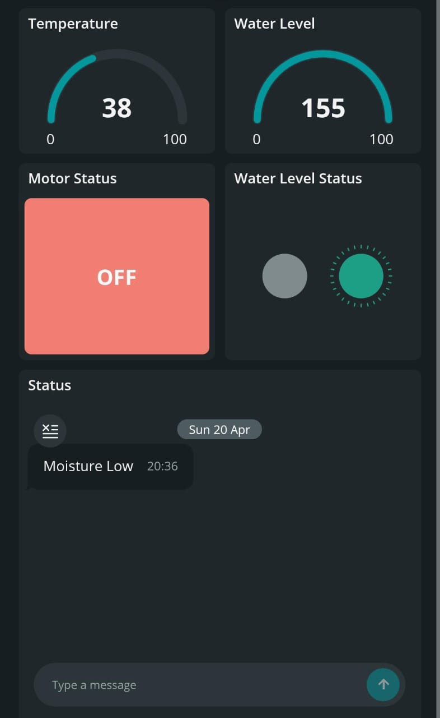
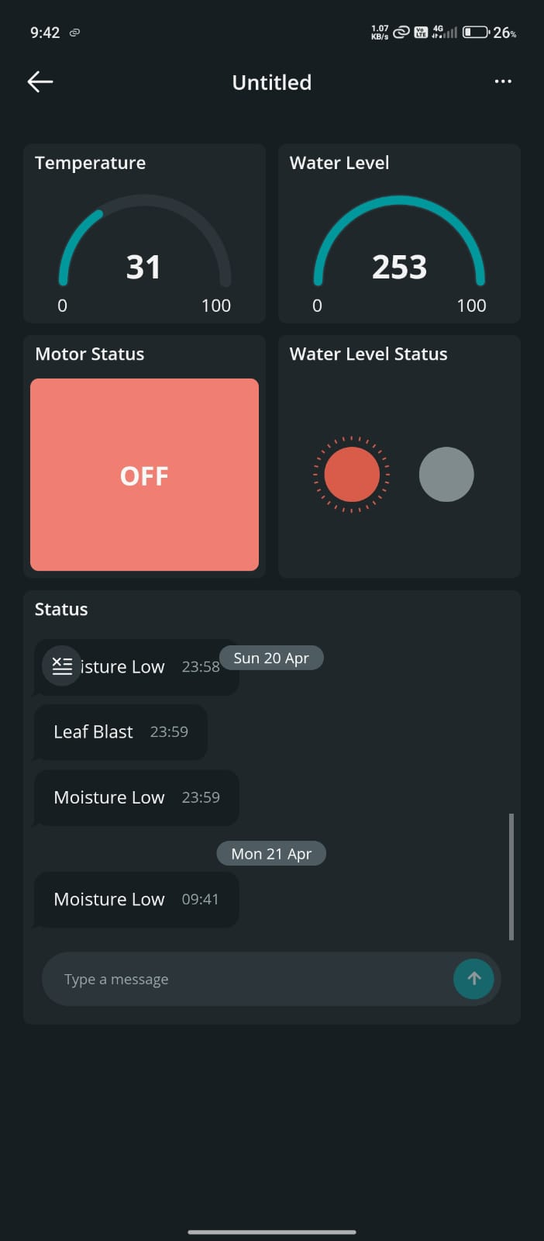
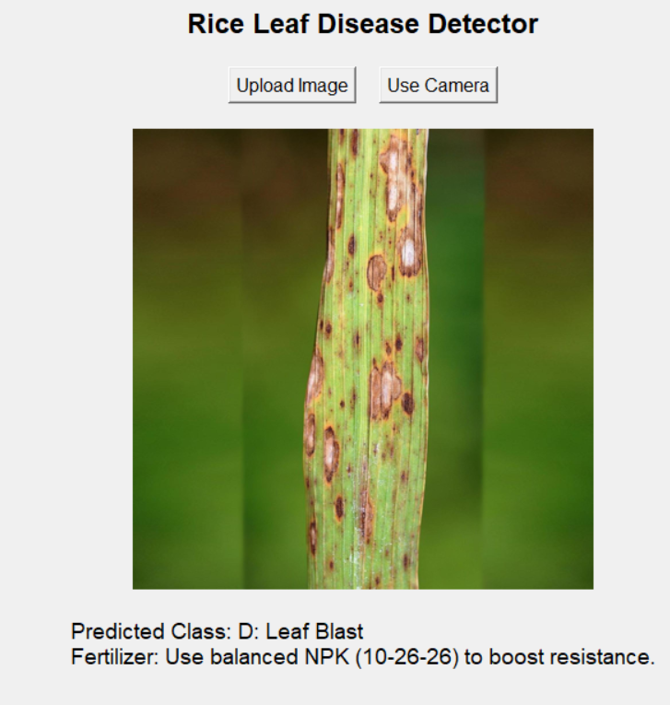
RESULT
Fig 2: Result of the Proposed System

Slide 12
ADVANTAGES
Resource Efficiency: Optimizes water and fertilizer use, reducing wastage and lowering operational costs.
Improved Crop Health: Detects diseases early and provides tailored fertilizer recommendations, leading to healthier crops.
Sustainability: Minimizes environmental impact by reducing water consumption and chemical overuse.
APPLICATIONS
Precision Irrigation: Automates irrigation based on real-time soil moisture and water level data.
Crop Health Monitoring: Detects and diagnoses crop diseases, providing early intervention for better yields.
Smart Fertilization: Recommends targeted fertilizer application to enhance growth and yield based on soil and crop conditions.

Slide 13
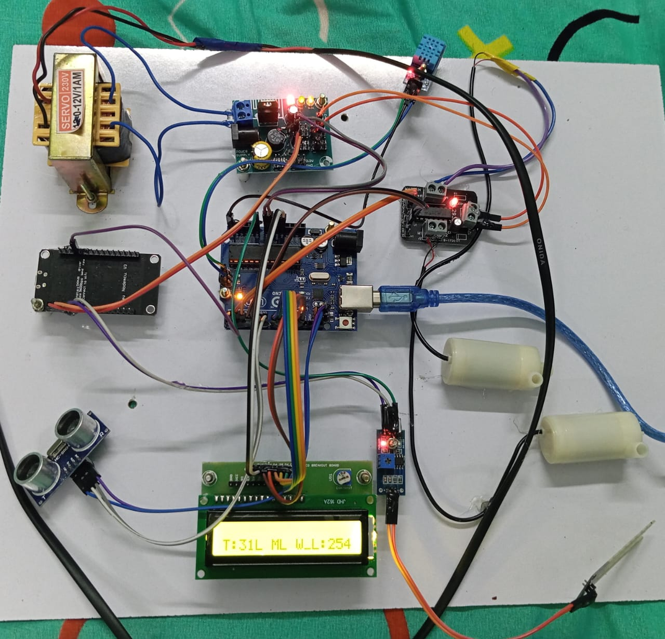
WORK MODULE

Slide 14
CONCLUSION
The system integrates IoT, automation, and machine learning(YOLO) to optimize farming and crop health.
IoT-enabled sensors ensure precise irrigation, fertilization, and early disease detection.
It reduces water and fertilizer waste, increases crop yield, and promotes sustainable, scalable agriculture.

Slide 15
REFERENCE
Lokanandam J K S Sai Ganesh, Mohit N Raate, Nithin T N, Pavan G and S Prof. Nithya shree, "Precision Agriculture robot for seeding function and Leaf Detection", International Journal of Engineering Research & Technology (IJERT), vol. 9, no. 08, August 2020.
P.A.H. Vardhini and M.L. Makkena, "Design and Comparative Analysis of On-Chip Sigma Delta ADC for Signal Processing Applications,“ International Journal of Engineering Research & Technology (IJERT),Vol. 24, 2021.
Ramesh T., Verma A., Srinivasan P., “IoT-Enabled Smart Irrigation System Using Soil Moisture and Weather Prediction”, Int. J. Electr. Comput. Eng. (IJECE), 2022.
Meenakshi R., Rajendran V., “IoT-Based Smart Farming System for Disease Detection and Irrigation”, IJACSA, 2023.
N. Sharma, K. Anand, and M. Thomas, “Deep Learning-Driven IoT Framework for Early Detection of Plant Diseases in Rice Farming,” in IEEE Internet of Things Journal, vol. 11, no. 2, pp. 988–996, 2024.

